Slide 1
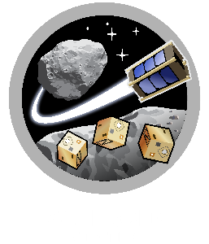
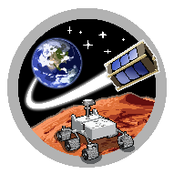
ASTEROID
SpaceTREx
SPIKE: Evolving Design & Mobility for Asteroid Exploration
Felicity Aldava
Mentors: H. Kalita, Jekan Thangavelautham
Space and Terrestrial Robotic Exploration (SpaceTREx) Laboratory
Aerospace and Mechanical Engineering Department
University of Arizona

Slide 2
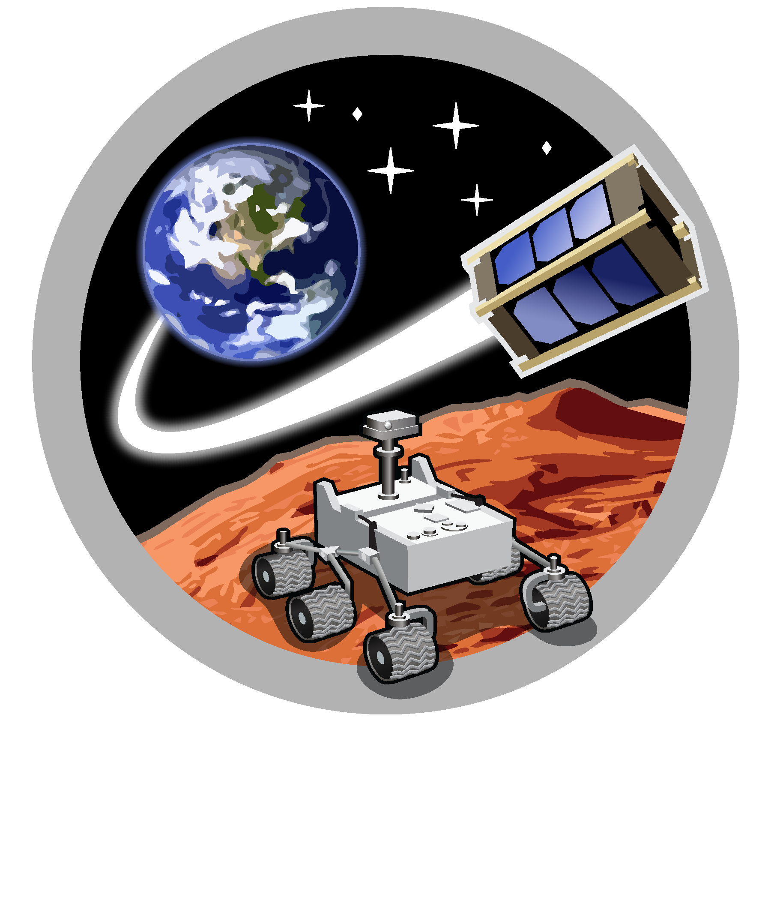
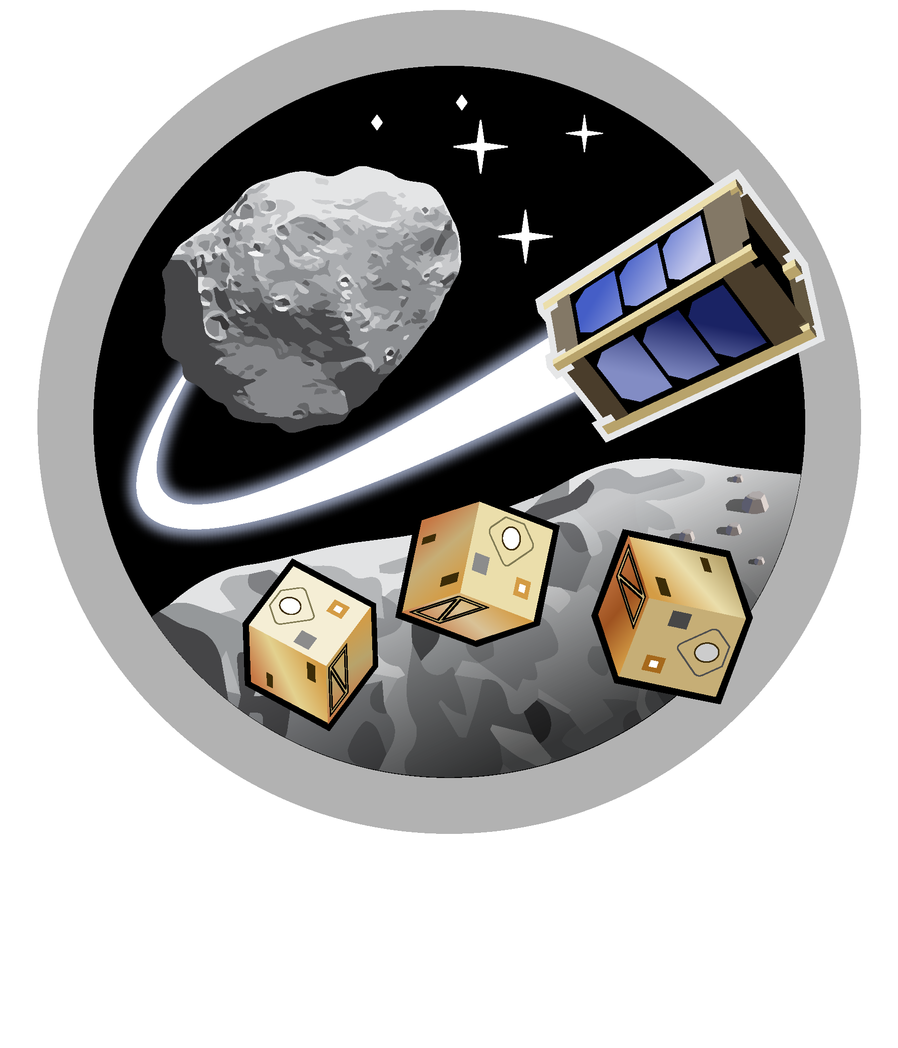
Asteroid Science, Technology and Exploration Research Organized
by Inclusive eDucation (ASTEROID) Center
Space and Terrestrial Robotic Exploration (SpaceTREx) Laboratory

Slide 3
Why is Asteroid Exploration Important?
There are 2 million asteroids in the solar system that vary in shape, size, composition and origin.
Asteroids provide critical insight into the origins of the solar system.
Sampling the surface and subsurface of these bodies is one of the best ways possible to attain insight

Slide 4
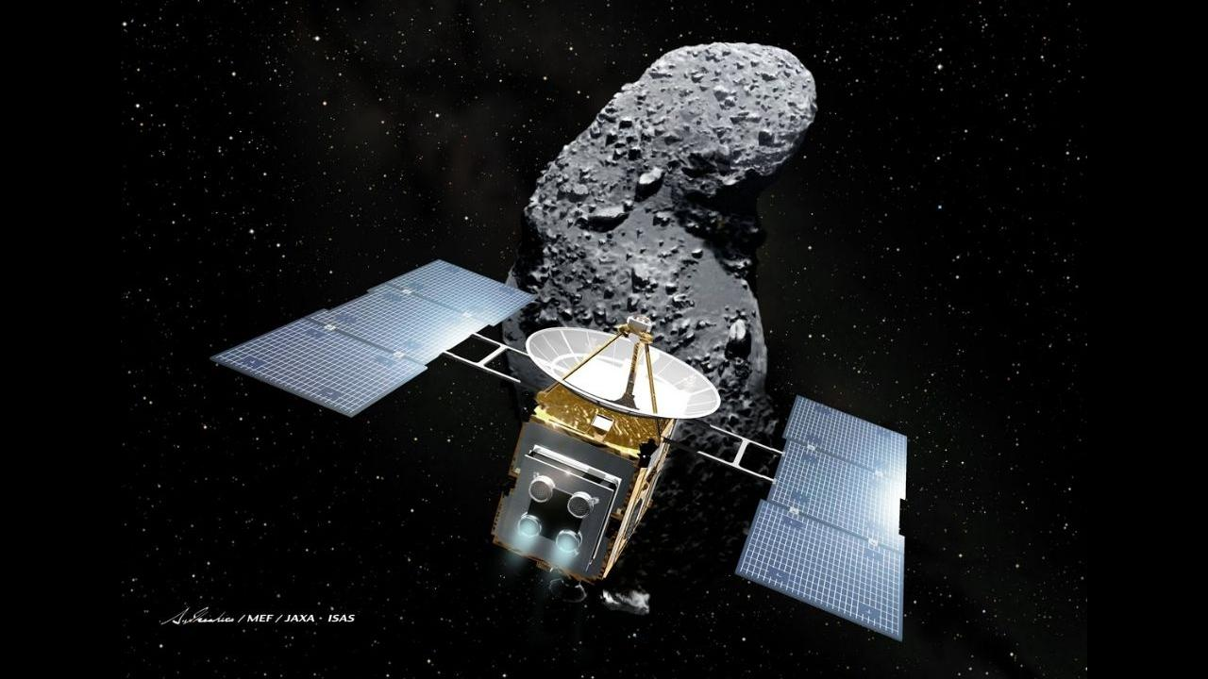
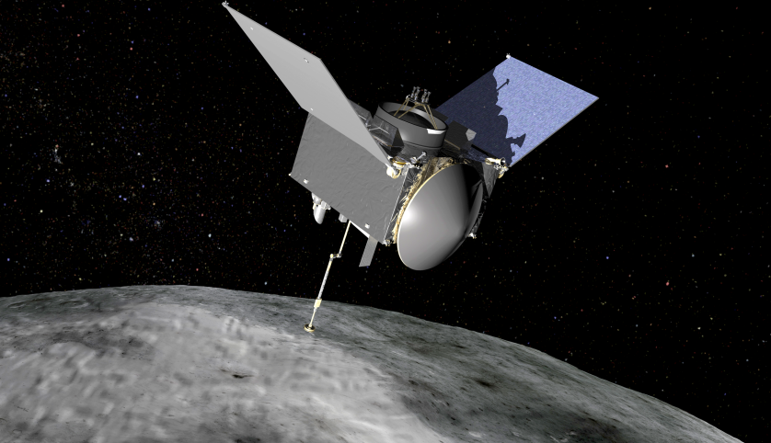
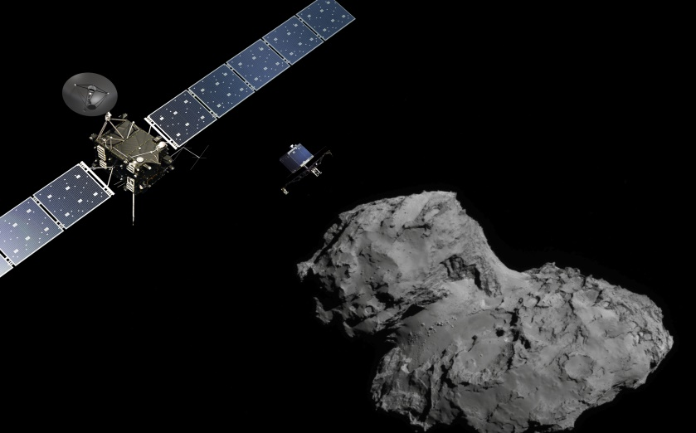
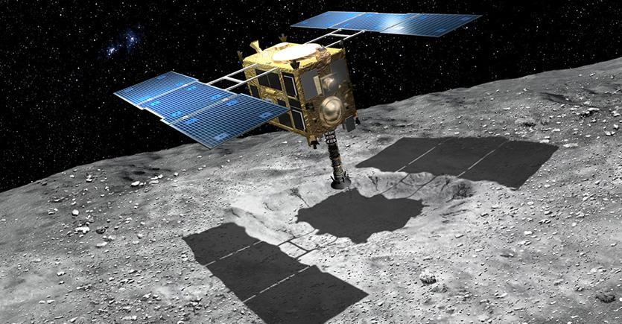
Examples of works to be used in the exploration of asteroids:
Hayabusa I
OSIRIS-Rex
NASA/UArizona
JAXA
Rosetta
Hayabusa II
JAXA
ESA

Slide 5
The Issue:
Touch and Go Operations Only
Able to collect only few samples
Unknown hazards of an asteroids surface and atmosphere
Asteroid mobility
Low-gravity, low-escape velocity
Surface contact risks
Dust
Static charge
Tracking and communication
Varying high and low temperature

Slide 6
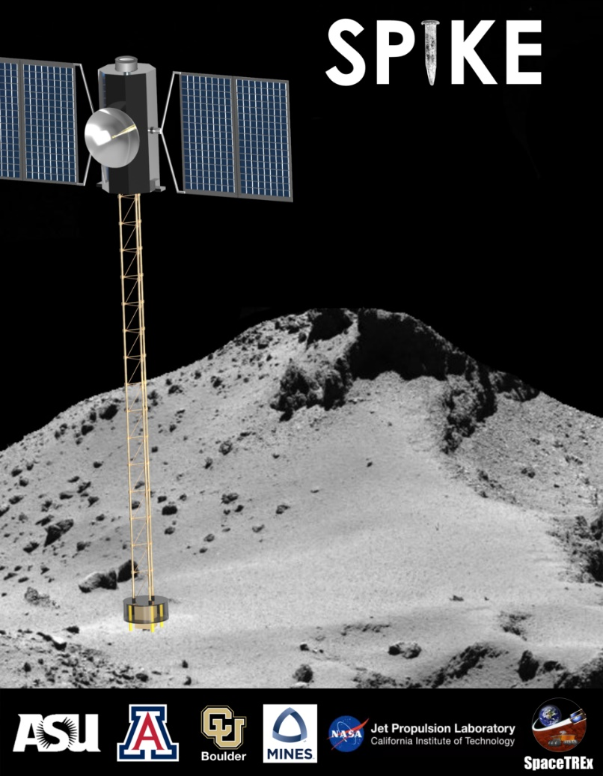
The SPIKE
Stands for Spacecraft Penetrator for Increasing Knowledge of NEOs
This concept is unique because the idea is a hybrid lander and flyby spacecraft with one or more booms to hop to places on an asteroid
The idea is to keep the actual bus of the craft away from the surface of an asteroid to avoid previous hazards
This would allow more opportunities to:
Collect multiple samples from a singular asteroid
Move around an asteroid to obtain samples
Allow for longer expeditions

Slide 7
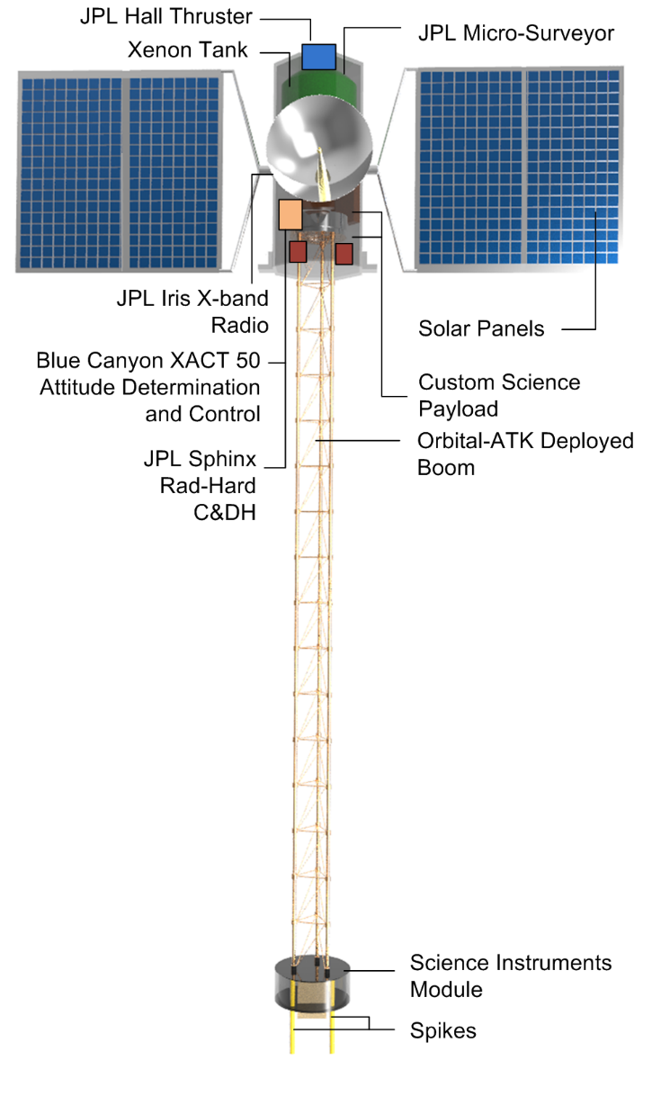
Current Design
Hybrid lander/flyby spacecraft
Based on JPL Micro Surveyor
Propelled by xenon fueled solar-electric Hall thrusters (5km/s delta v)
Solar panels can generate 750W
Blue Canyon’s XACT 50 (star-tracker, IMU, 3-axis reaction wheels)
JPL’s DSN compatible IRIS X-band Radio V2.1 (256 KBps)
Image Source: arxiv.org

Slide 8
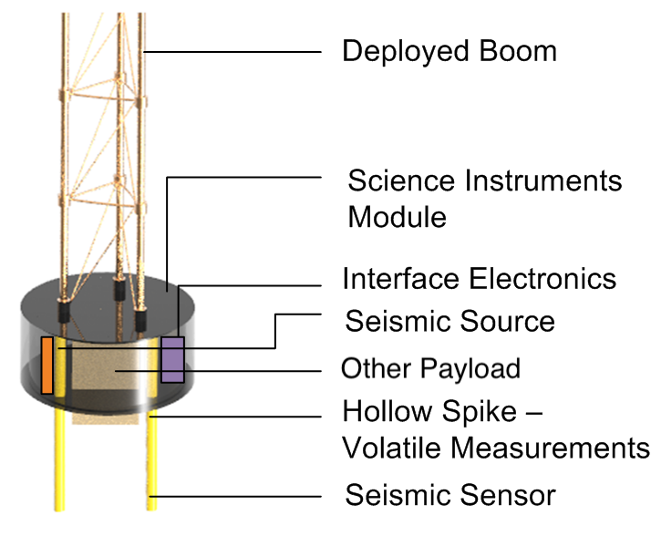
The Extendable Boom
Capabilities
Analyze subsurface volatiles and organics
Conduct seismology
Payload
Seismometers
Cameras
Other instrument will be designed to access >10 cm beneath the surface of the asteroid
Image Source: arxiv.org

Slide 9
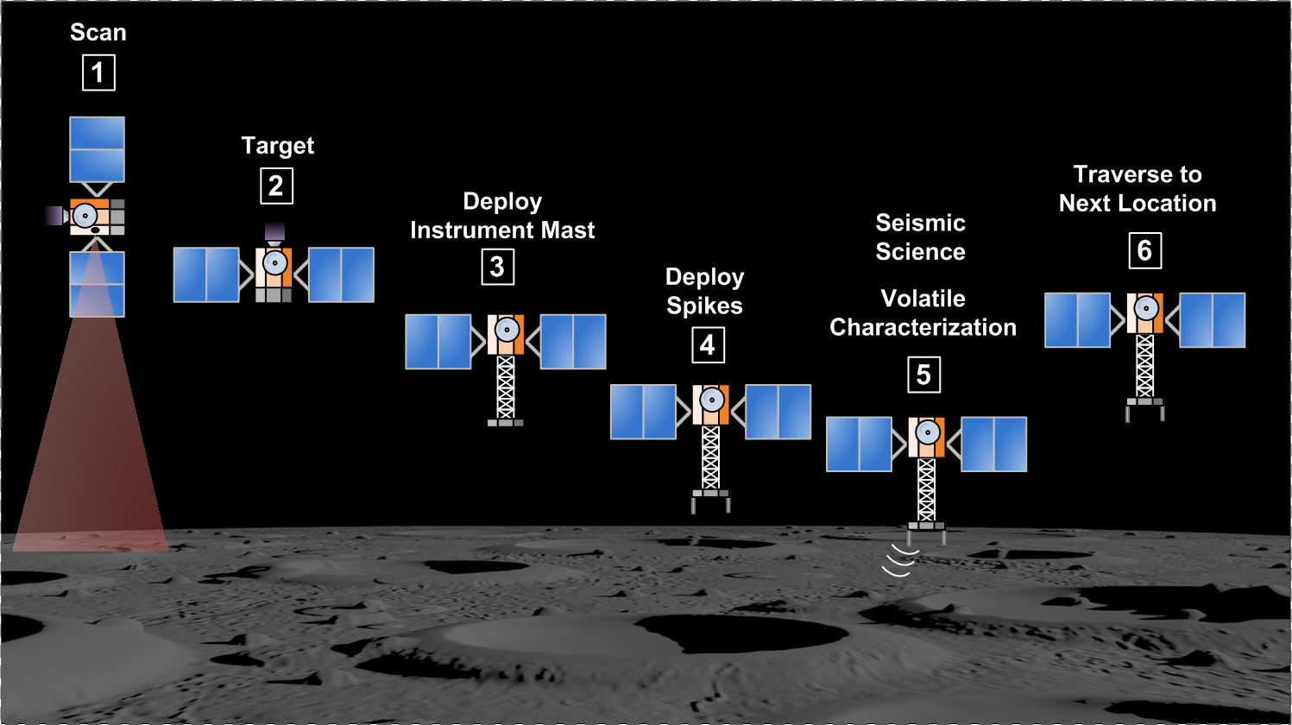
The idea for movement is to follow this process repeatedly, moving to different locations on the asteroid.
Image Source: arxiv.org

Slide 10
Continuing The Work
This has all been done before entering the lab.
What was next is the possibility of enhancing the design of the SPIKE and how it moves
How would this be done?

Slide 11
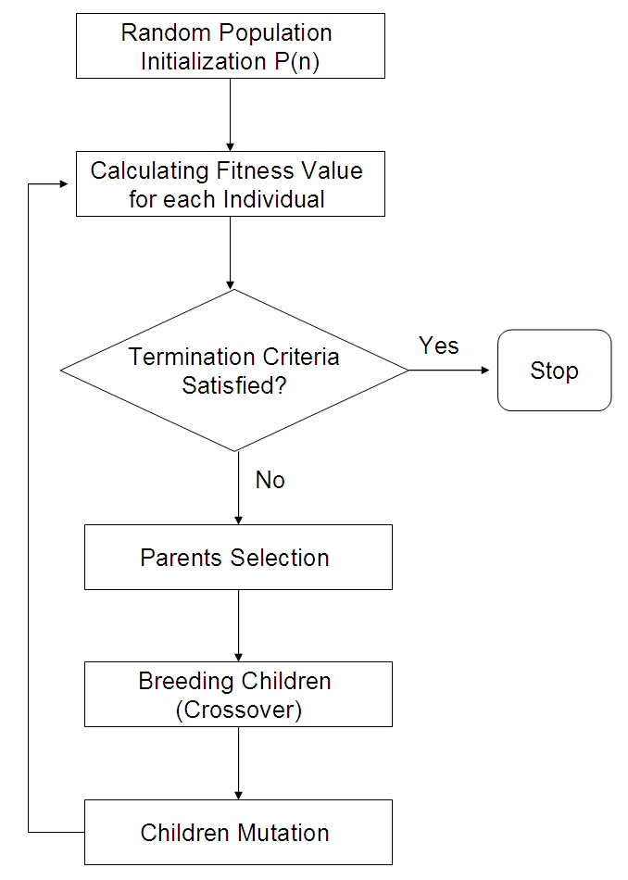
Evolutionary Algorithms
Main purpose is to optimize
Uses the concepts of evolution to achieve the optimal solution.
General Process: (Seen in image)
Create initial population
Test population
If solution found stop, else determine which in the population performed best
Create new population from selected and mutate new population if necessary
Repeat at Test population until optimal solution is found or no progress is being made.
Image Source: researchgate.net

Slide 12
Our Purpose for Evolutionary Algorithms
For our purpose they optimize the number of legs and joints the SPIKE would consist of.
The current SPIKE consists of a singular boom, like a pogo stick.
To extend this design we started with a simple change, 2 legs.

Slide 13
Extended Design
Two booms (legs)
Consisting of 3 links (the body, the knee, the foot)
Connected with revolution joints
Humanoid like
This design would allow for a walking and hopping motion compared to the previous which would move around like a strictly like pogo stick.
The movement would be like walking for a human.

Slide 14
Testing
To test this model we would run it through a simulation, allowing it to learn how to walk in varying gravities.
Example Gravities:
9.81 m/s^2
3.71 m/s^2
1 m/s^2
.5 m/s^2

Slide 15
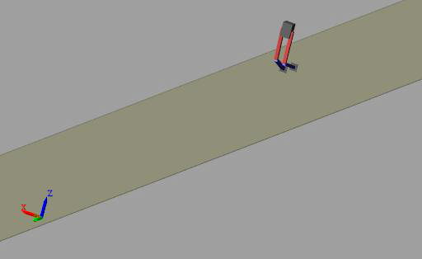
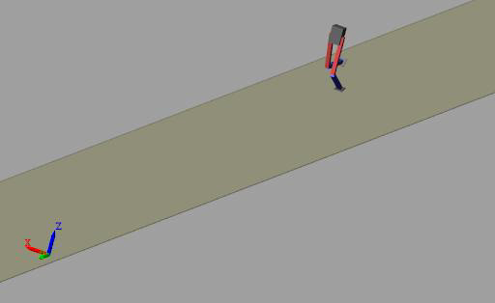
From as low as 1 m/s^2
Generation 1 Generation 150

Slide 16
Analysis of Previous Videos
As seen in the given example videos
High gravity should lead to an attempt at a walking motion (Not Shown)
Lower gravity should lead to a hopping(skipping)/walking motion by staying up longer

Slide 17
There is still work to be done
As of now this project is in its infancy and has a lot more to be done.
In the future we hope to
gain more insight into how evolutionary algorithms can help solve problems
Achieve an optimal design for The SPIKE
Explore asteroids for longer periods of time
Collect multiple samples from an asteroid
However, many of these ‘In the future’ goals may be further into the future than others.

Slide 18
Acknowledgements
Space Grant Program for the opportunity
Mentors: Jekan and Himangshu
My family for pushing me through to the end
All of SpaceTREx for assistance when needed

